Slide 1

Processes, Threads and Concurrency Part I

Slide 2
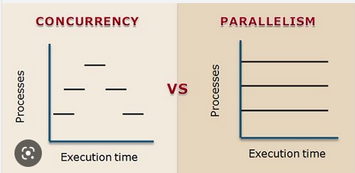
What is Concurrency?
Concurrency means happening at the same time
In computing it means that the computer can do more than thing at the same time
HOWEVER, we must distinguish between concurrent (same interval of time) and parallel (at the same instant of time)
One CPU can only perform concurrent operations
Multiple CPUs or cores can perform parallel/simultaneous operations (each CPU does work at the same instant of time!)

Slide 3
Why Concurrency?
For more responsive systems
For increased performance via parallelism
Why not concurrency?
It brings non-determinism
Specific knowledge and programmer discipline needed

Slide 4
Origins

Slide 5

Origin of the OS Process
She’s been hogging the machine all morning and I can’t get anything done!
Early computers were able to only run one 'Job' at a time

Slide 6
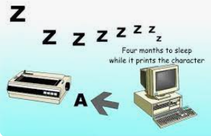


IO vs. Machine Instruction Execution
IO – printing, writing to disk : Milliseconds
Executing CPU instructions : Nanoseconds
How many nanoseconds in a millisecond?
Answer: 1_000_000
HOW?
Hey, while program-1 is doing IO, why don't we figure out how to get program-2 to run concurrently!
Add Interrupt capability to the CPU

Slide 7
Interrupts
An interrupt is a signal sent to a computer's CPU (Central Processing Unit) that indicates the need for the CPU's attention.
Interrupts are used to interrupt a program (process) and switch the CPU over to another program (process)
The CPU stops executing its current instruction and saves the current program state, such as the value of the program counter and the contents of the CPU's registers, onto the stack.

Slide 8
What does a process know?
It's code == the program it’s running
Program counter
CPU registers
CPU scheduling information
Memory-management information
Accounting information
I/O status information
On a CPU only ONE process can be running at one time

Slide 9
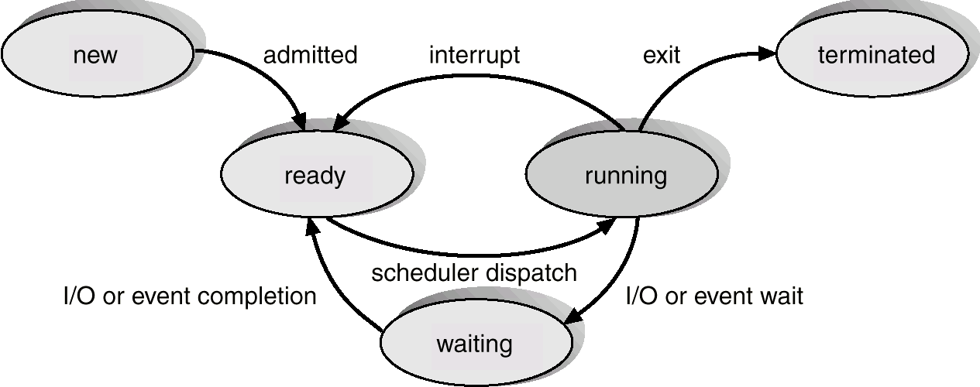
A Process “Maintains State”
The ability of a CPU to interrupt a process enables multitasking!

Slide 10
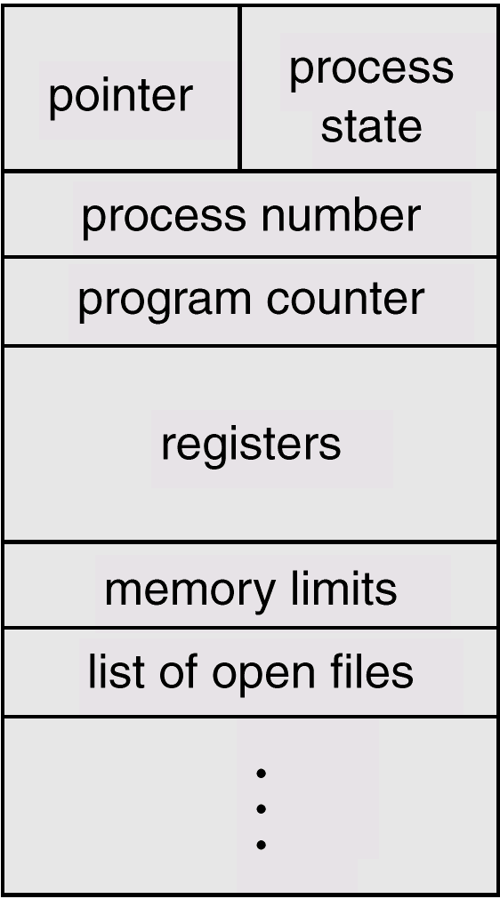
My data structure is my PCB
Process Control Block (PCB)

Slide 11
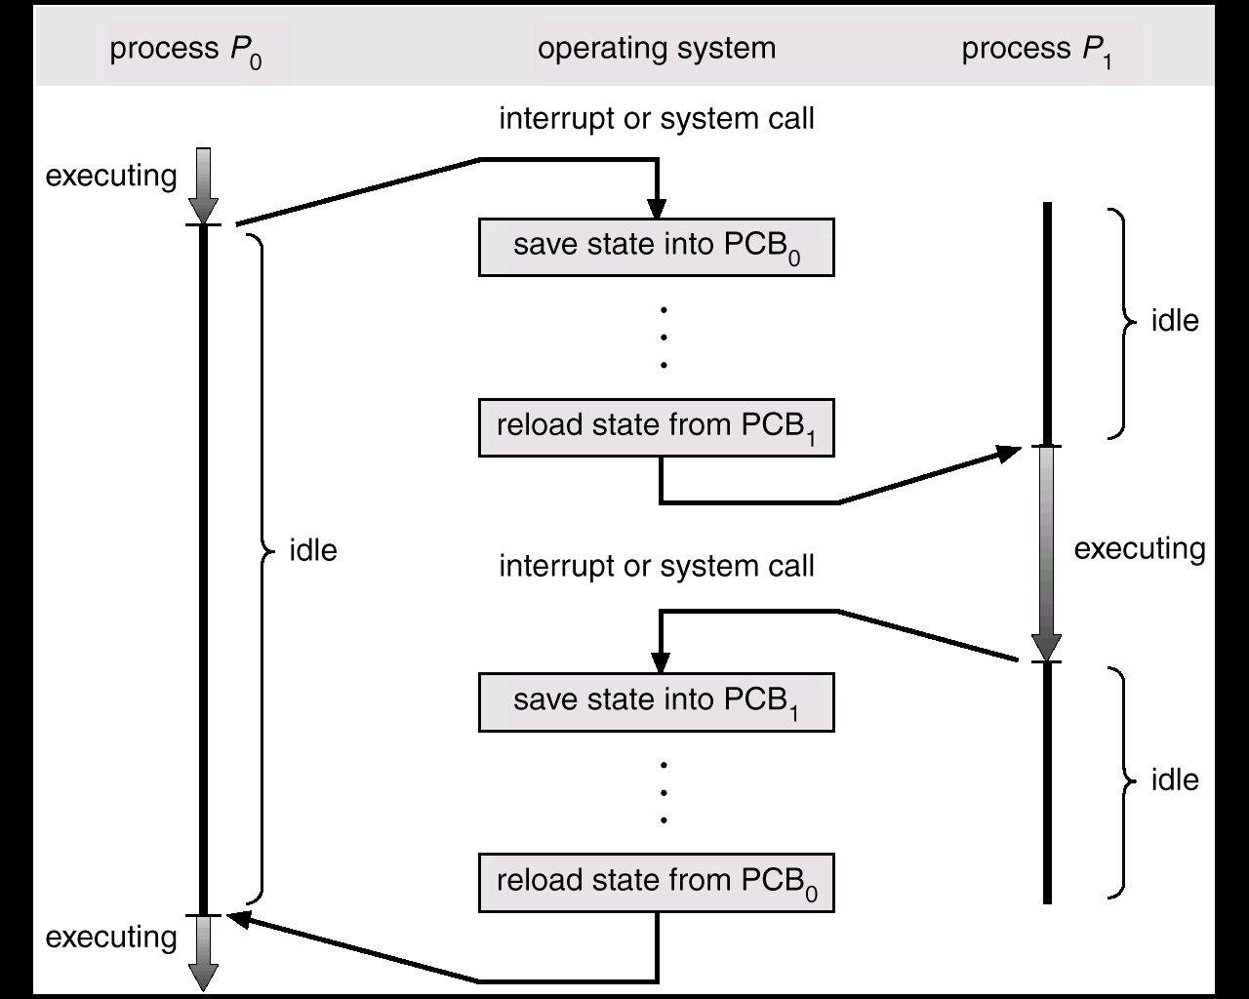
CPU Process Switching – after Interrupt

Slide 12
The Process “Scheduler”
The OS process scheduler assigns the CPU to a process
Early OSs relied on each program to give back the CPU – called cooperative multitasking
This evolved into preemptive multitasking – where the scheduler takes back the CPU
Preemptive is preferred, as cooperative multitasking fails when a single process forgets or is unable to relinquish control of the CPU. If such a scenario occurs, the computer is "blocked".

Slide 13
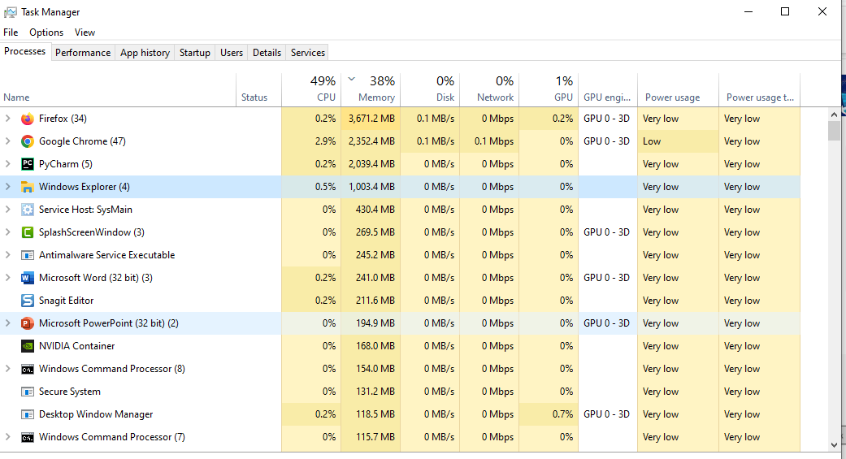
Windows – CTl-Alt-Del Select Task Manager to see your Processes

Slide 14
What about Threads?

Slide 15
Threads vs Processes
A process has its own address space
In a multitasking operating system, each program is run as a separate process
Process switching has significant overhead
A thread shares the address space of the the program that created it
threads provide concurrency within a process
all the data for a process is available as a thread
every running program is said to have MAIN thread

Slide 16
Why Threads?
Provides parallel computation with low overhead
Use threads when a program may need to wait for some resource
disk access, network connection
When one thread is waiting (blocked), other threads can continue processing

Slide 17
Threads
Each thread has its own program counter and call stack
threads can be executing different functions with a program concurrently
Multiple threads will share the process address space which may contain global variables which can be used for communication among the threads.

Slide 18
Threads are useful…
get work done while other threads wait for slow devices
respond to multiple user inputs
can handle network services in the background
can take advantage of multiple processors

